Slide 1
An intro to Viasat
May 2021

Slide 2
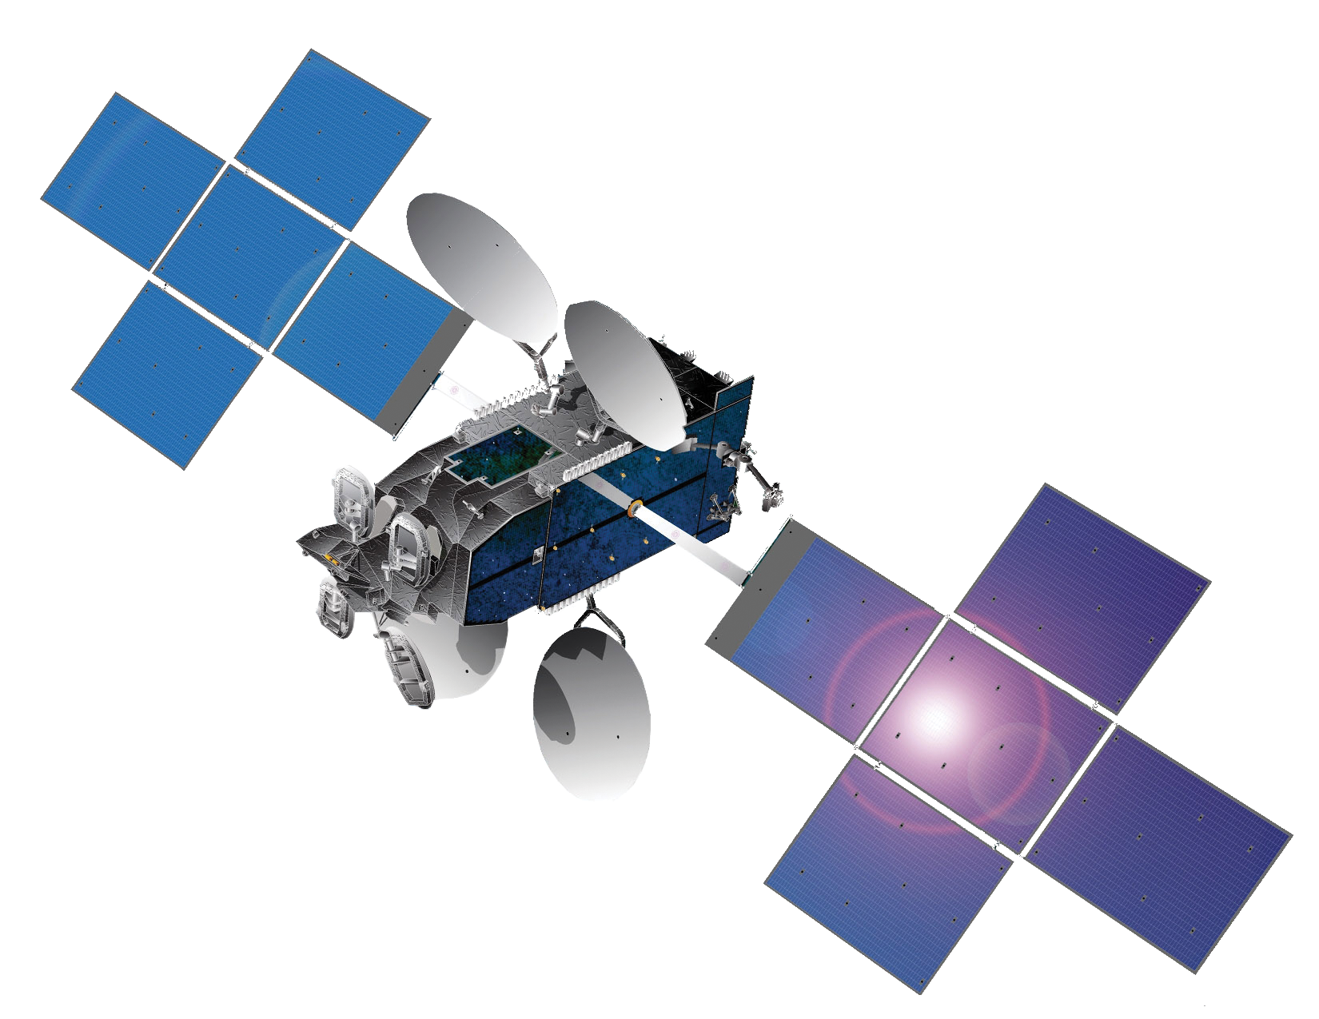
Connecting the world with satellites
“We’re developing the ultimate global communications network to power high-quality, secure, affordable, fast connections to impact people's lives anywhere they are—on the ground, in the air or at sea.”

Slide 3
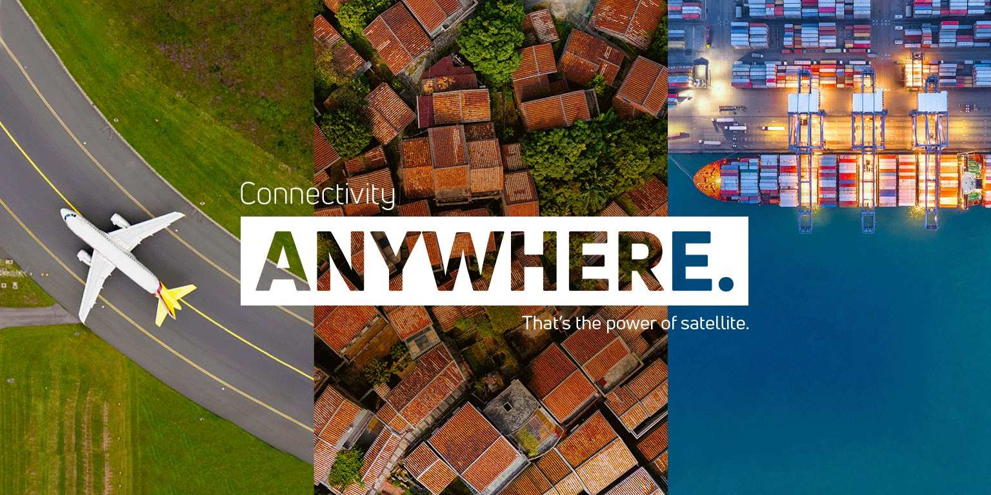

Slide 4
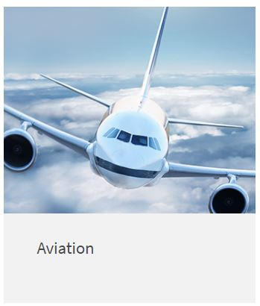
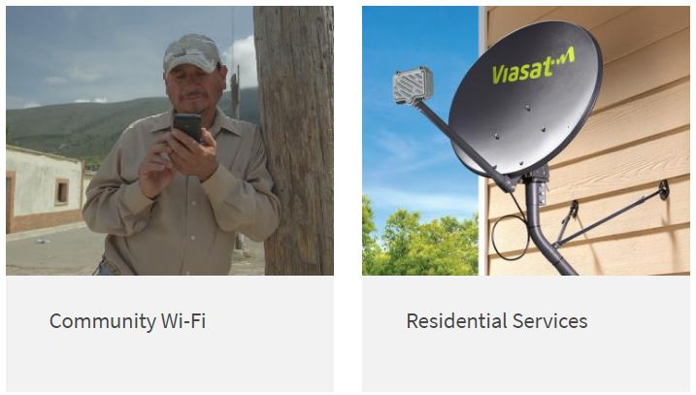
Viasat services

Slide 5
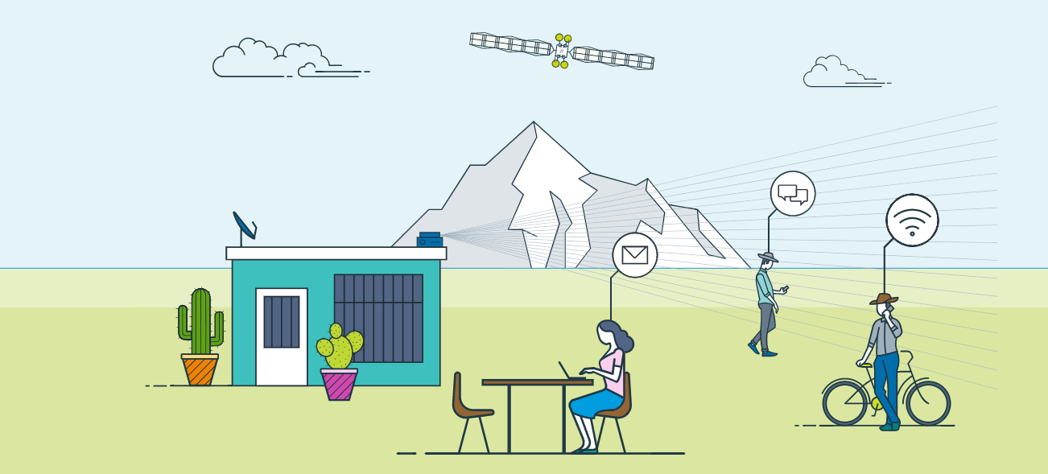
Community Internet
5

Slide 6



Community Internet

Slide 7

Viasat in Brazil
July 2020:
Viasat launches Premium Residential Internet Service in Brazil; We became the first satellite ISP to make high-speed internet available across 100% of Brazil

Slide 8


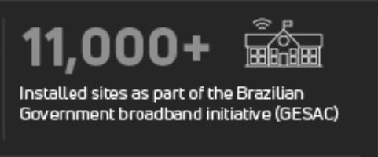
Bringing the potential of the internet to all

Slide 9
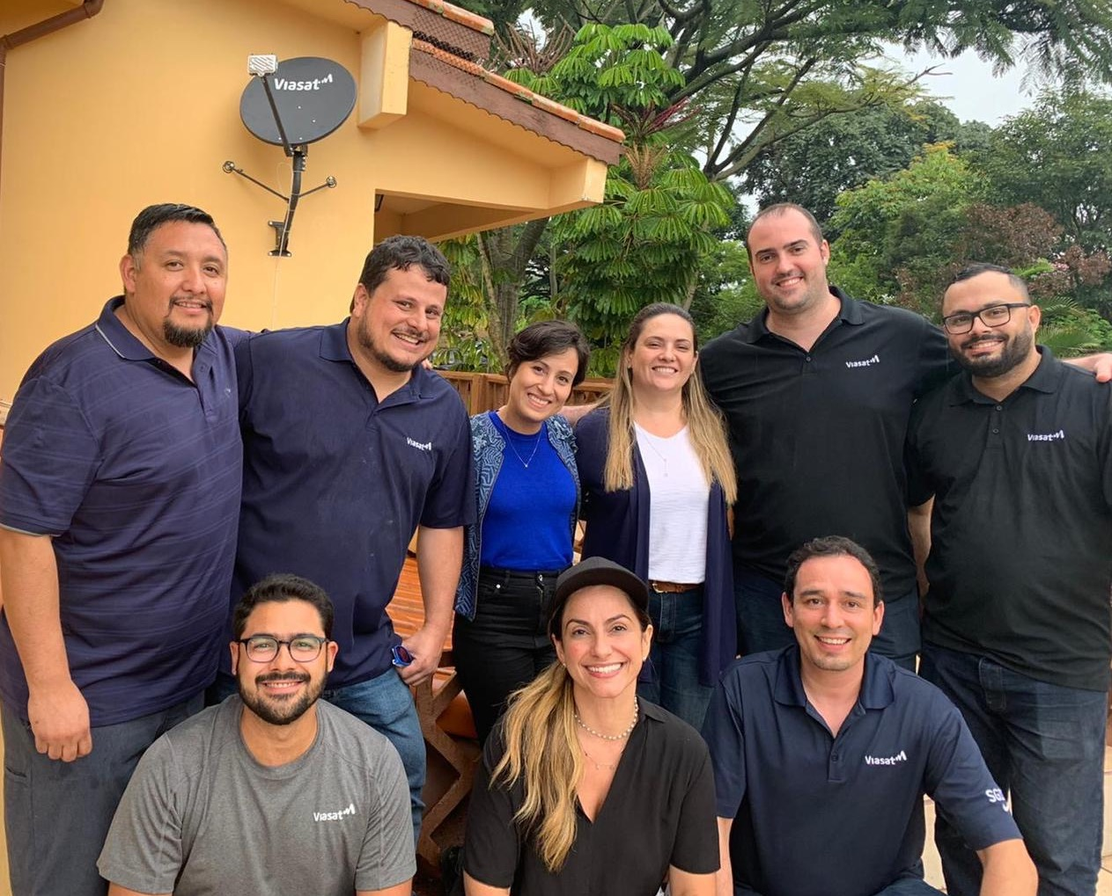
Our growing team in Brazil

Slide 10
Speedtest App

Slide 11
Motivating problems
No multiple app support
Viasat and other ISPs treat different application traffic differently
A speedtest that sends generic TCP traffic to and from a server on the web will not adequately characterize the performance one might get using Zoom or YouTube.
True UX metrics
Many speedtests don’t capture the metrics that really reflect user experience
How fast did myvideo start?
What video quality did the network support?
How long was the video player in a “buffering” state?
How fast did myweb page load?
Batch/Scheduled tests
Speedtests usually are one-off tests that require user intervention
It is hard to get data over time

Slide 12
Motivating problems
Performance under load
Most speedtests don’t measure performance under load
Ex. When a background data transfer is happening, my Zoom call should not be impacted if a network is properly prioritizing Zoom over background data.
No network context
Only some speedtests will record your location and your ISP
Other potential needs
Querying a well-known address hosted by the ISP where the ISP could add additional contextual information about the access point
Satellite ex. Recording the beam
Cellular ex. Record the cell and the signal strength
Wifi and LTE signal metrics would be useful too
Congestion/utilization, traffic policy, etc.

Slide 13
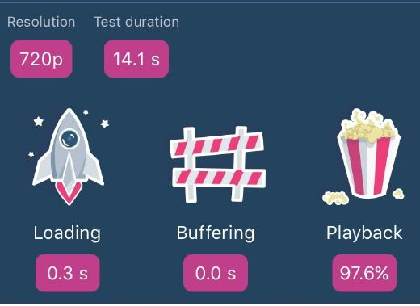
Current workarounds
Fast.com by Netflix
Simulates Netflix video to allow users to measure what kind of speeds their ISP is supporting for video traffic specifically.This is one tool that can help with #1 above.
Open Signal app
Has a “video test” that results in the UX metrics on the image to the right
Record the SSID or Cellular network on which the test was run.
https://testmy.net/
Runs in batch mode
Includes statistics across all the tests in a batch and a graph of those results over time
http://www.dslreports.com/speedtest
Measures a thing called “bufferbloat” which is the latency while a speed test is being run

Slide 14
Why PWA?

Slide 15
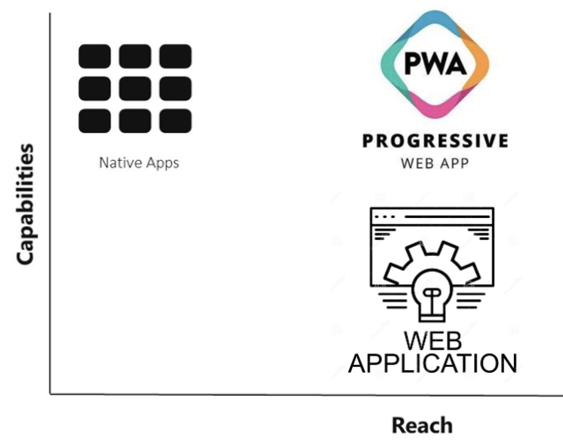








Progressive Web Apps
One app for everything.
Smartphone, tablet, and desktop.
Multi-platform
Lightning fast
(Prefetch/Caching)
Offline-ready
Native app functionalities
supported by:
Notes:
The good news is that the new PWA standard can solve all these issues.
Thanks to Progressive Web Apps (PWAs), you are able to create apps that work on desktop and mobile browsers, and can also be installed on mobile devices.
Thanks to a prefetch / caching (which is using Service Worker) PWAs are super fast, even with a slow internet connection, and can also work with no connection whatsoever.
This standard was created by Google and has now been adopted by Apple and Microsoft as well.

Slide 16

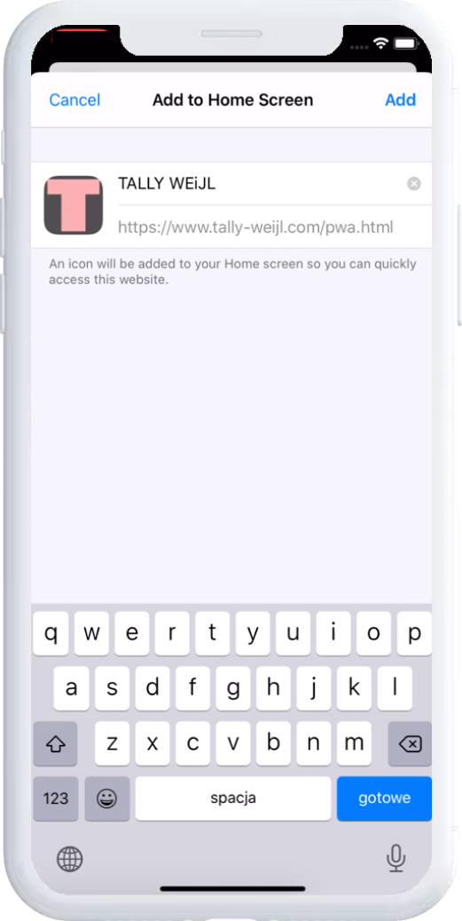
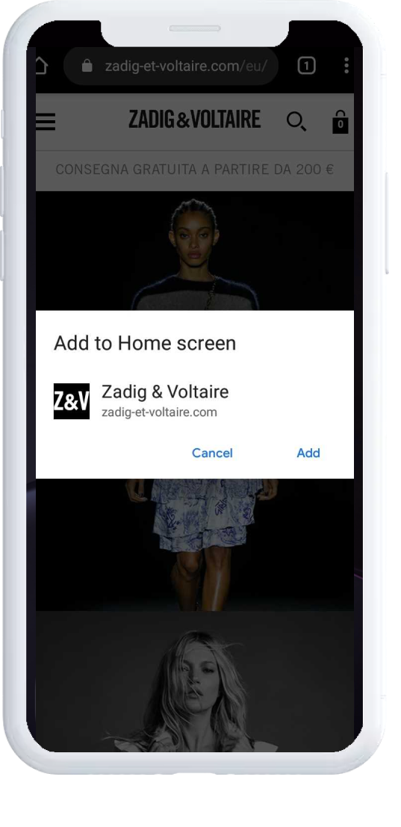
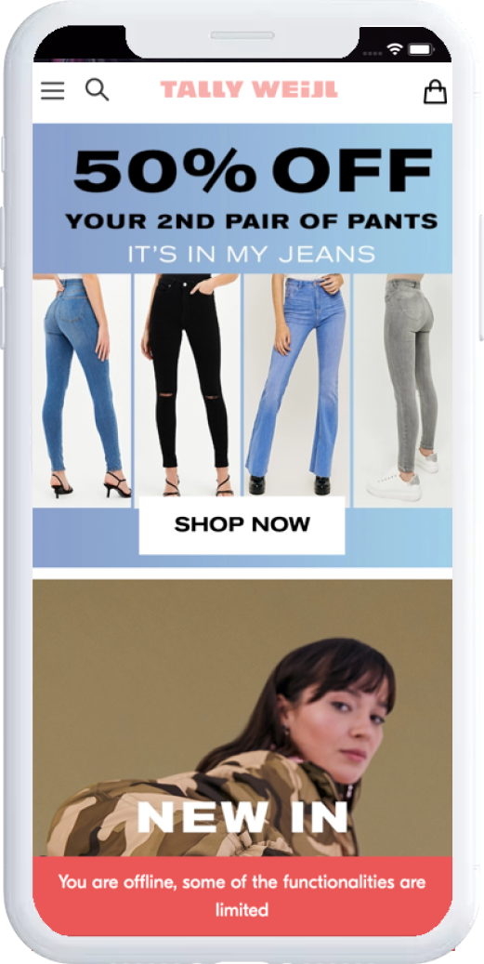
Provide native-app features
Vue Storefront feels just like an app—it even has app-style interactions and navigation.
Full screen
Hiding the browser’s top URL bar and the bottom navigation menu.
Home screen
Instant access from the home screen without opening the browser and typing a URL.
Push notifications
Push notifications with a one-click opt-in directly from the PWA site.
Offline mode
Browsing with a weak or even lack of a network connection.
Notes:
When we introduce a PWA, we usually start by showing this. This illustrates the power of the PWA.
Your website on mobile will look like and work like a native app.
You can create a native-like experience for the end-user using the PWA standard.

Slide 17
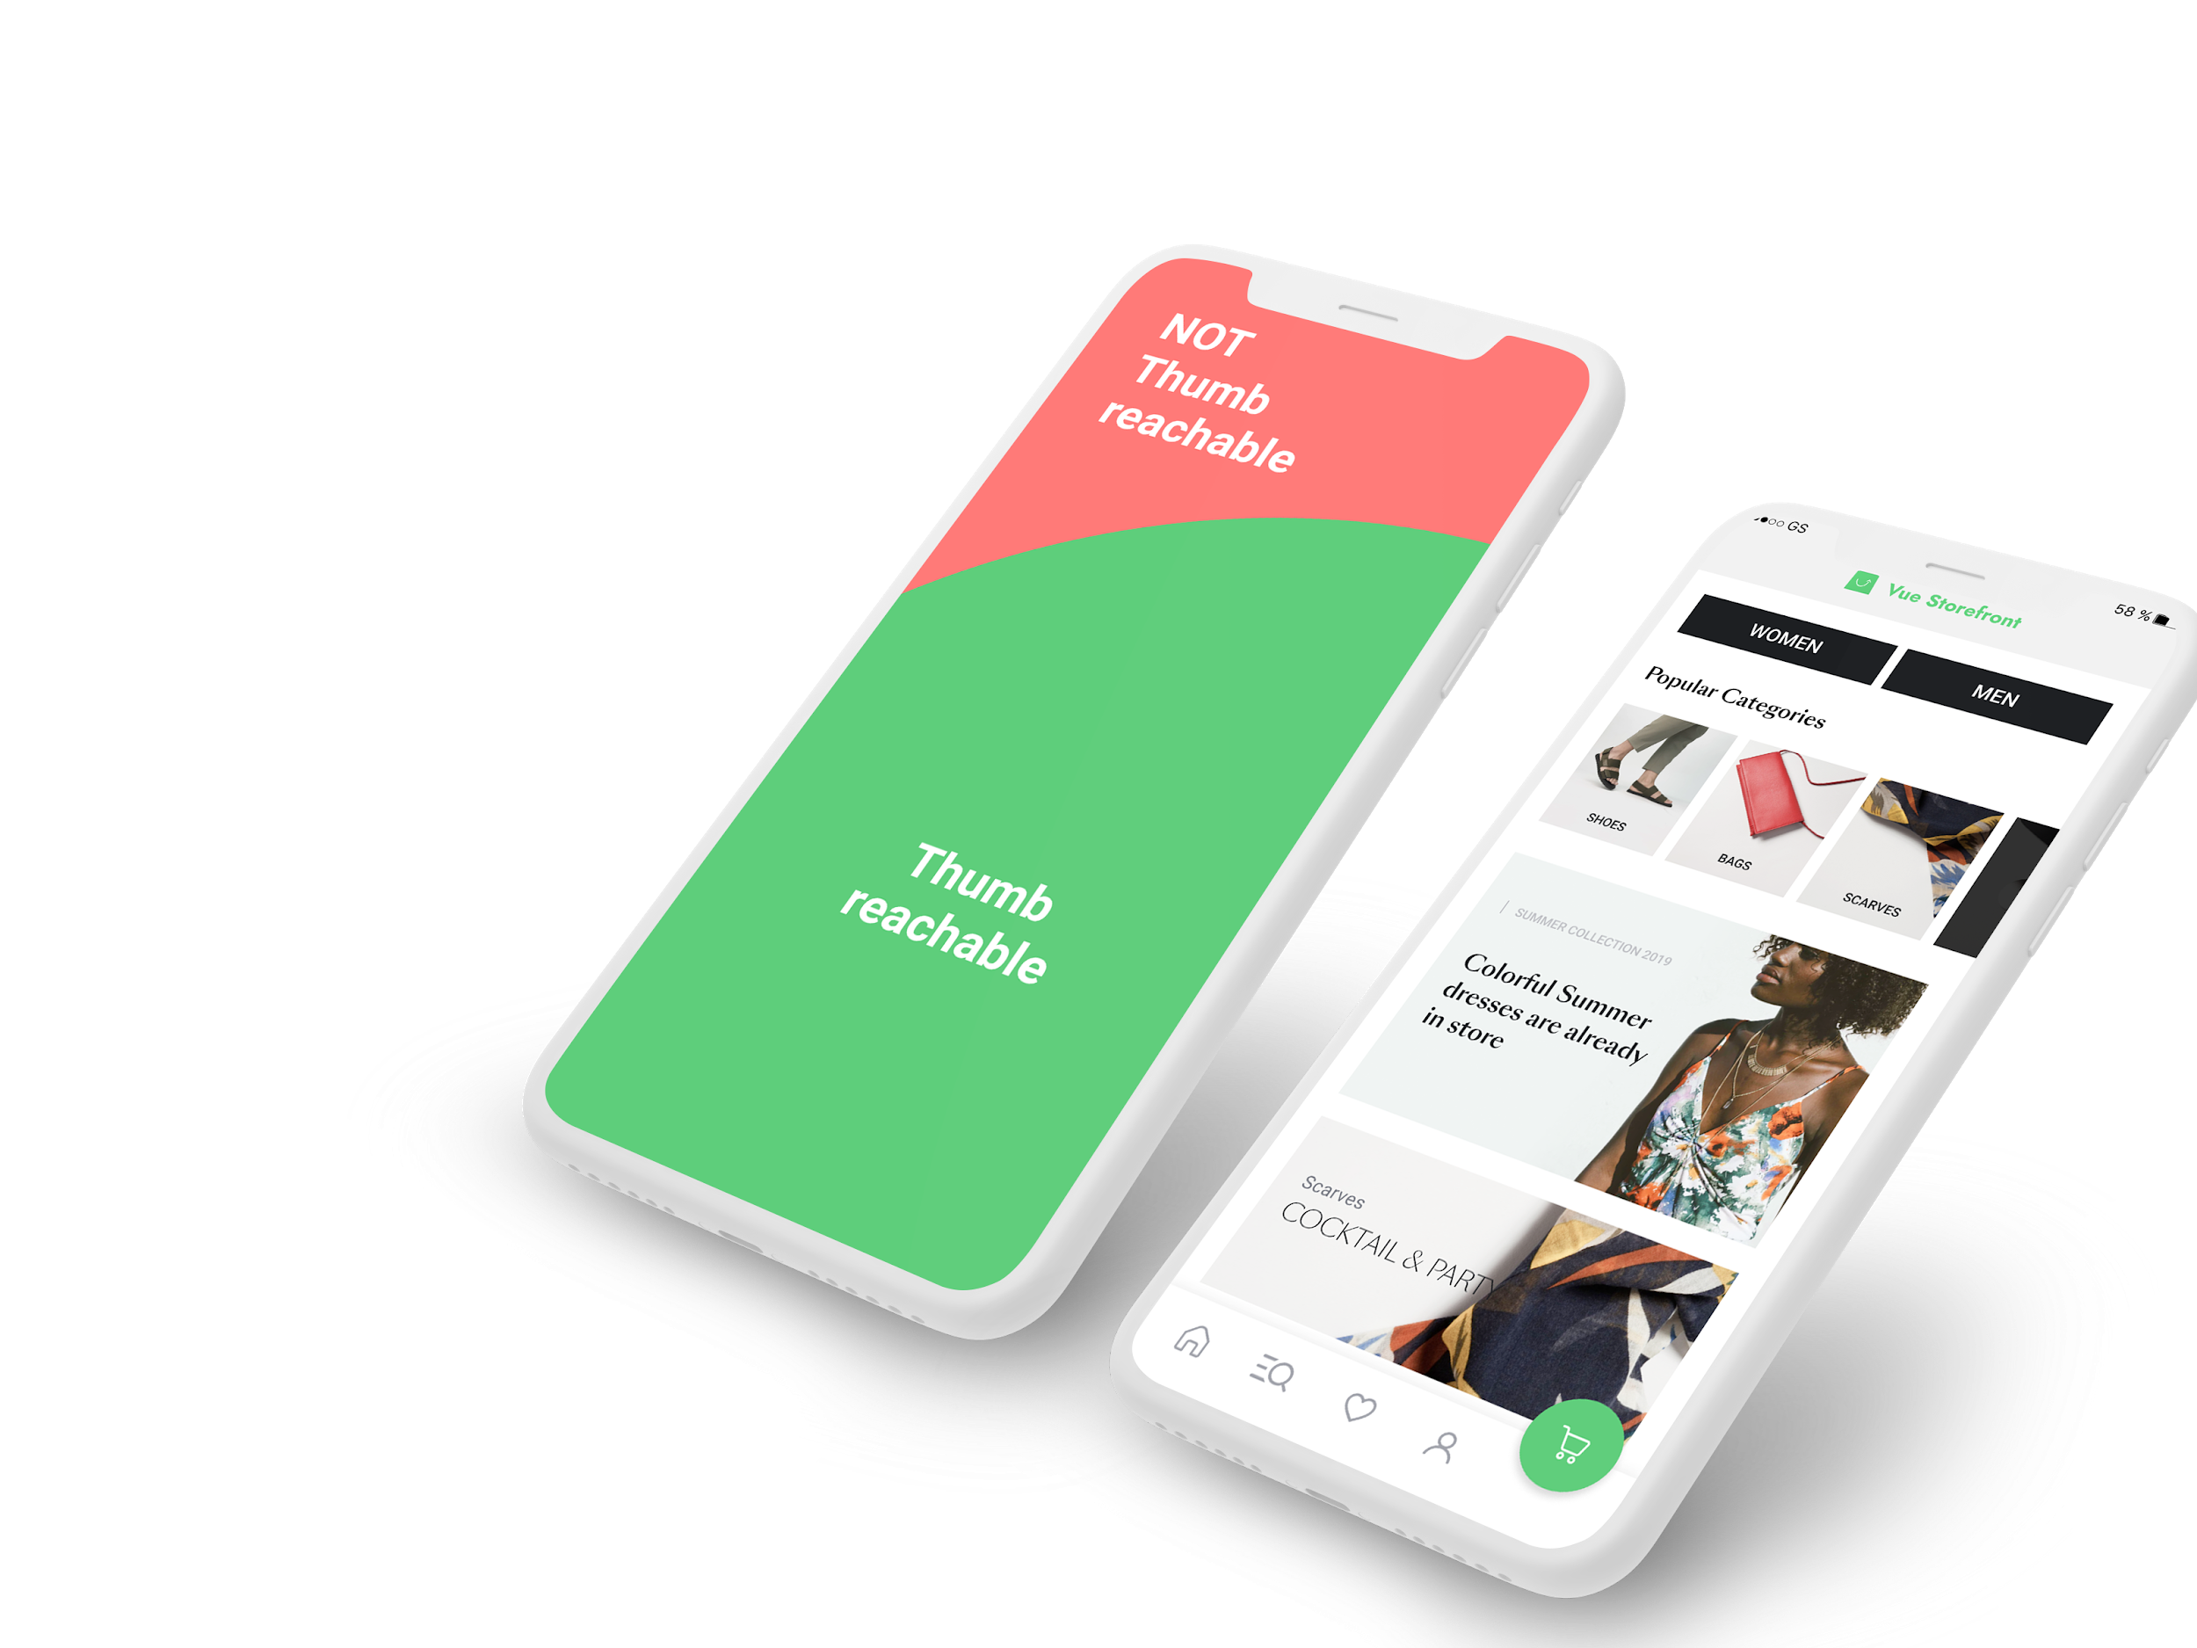
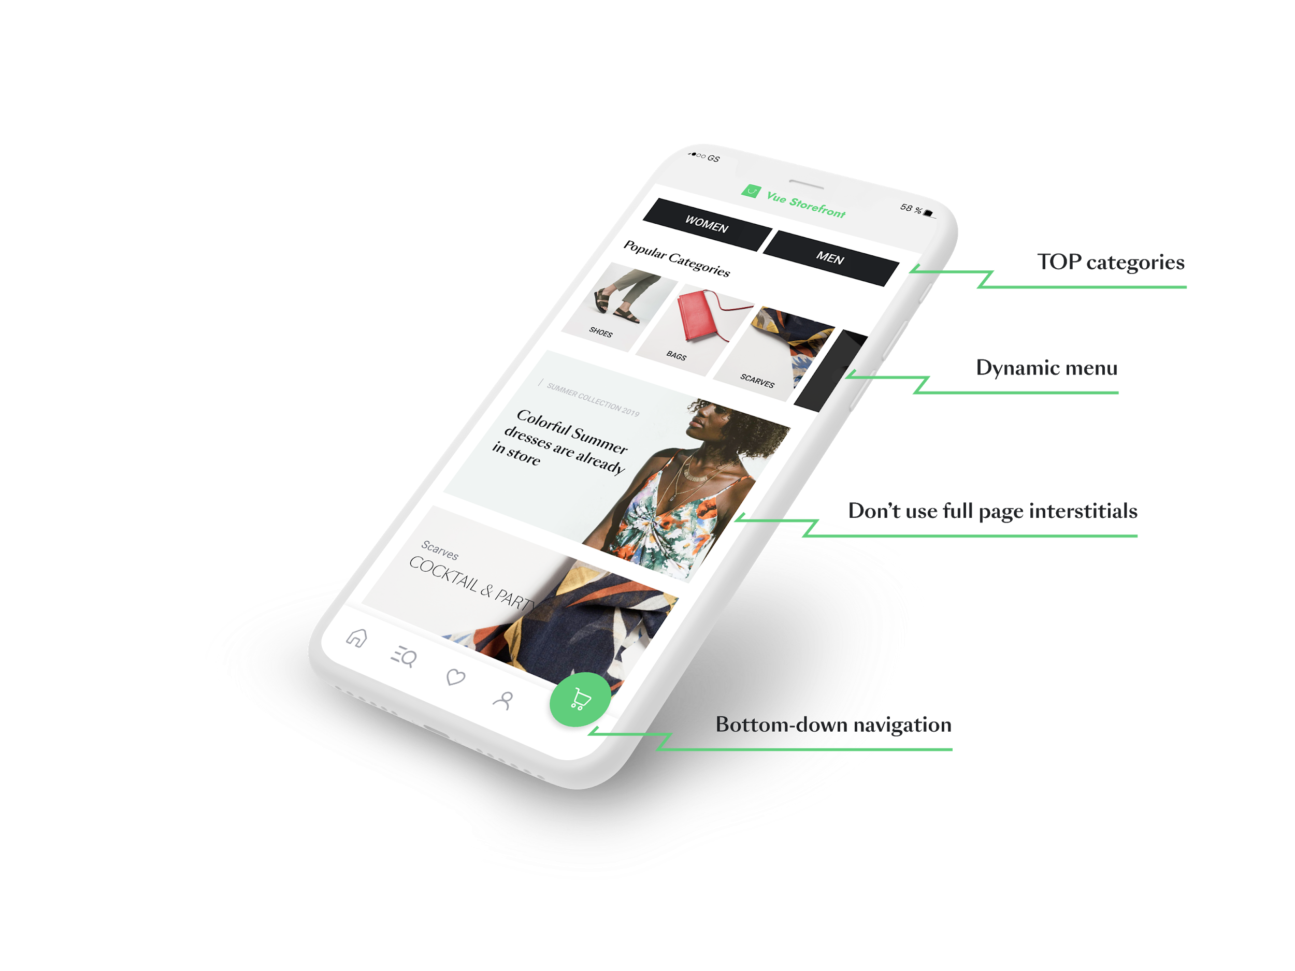
Possibility to provide true mobile-first design
The home page is a great place for a navigation.
Especially the center of the screen.
The typical hero slider doesn’t
work very well on mobile.
Don’t worry about being “above the fold”.
Notes:
It’s also quite a good idea to keep priority elements in the center and main navigation at the bottom of the screen.
As you see, a homepage is a great place for navigation. Especially the center of the screen. This is why the typical hero slider doesn’t work very well on mobile. We see that the top mobile e-commerce sites are moving away from this component.

Slide 18
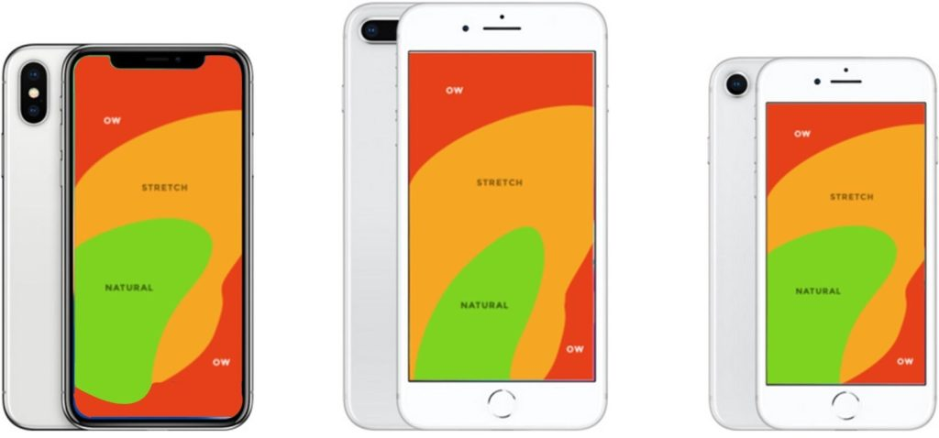
Basic understanding of mobile ergonomics
Users usually hold the phone one-handed (49%).
The span of possible gestures is very narrow.
The Steven Hoober study: “How Do Users Really Hold Mobile Devices”.
Notes:
Sorry for being philosophical, but we need to realize that the touchscreen isn’t a natural interface for us.
This means the span of possible gestures is very narrow.
With very different phone sizes, it’s harder and harder to design an ergonomic UI.

Slide 19


















Progressive Web Apps are already here...
...and they deliver strong results.
+300%
increase in revenue at Best Western Hotels
+100%
increase in engagement
at Forbes.com
+74%
increase in time spent on AliExpress
+70%
increase in conversion rate at Flipkart
+3X
increase in conversion rate
at MakeMyTrip.com
+3X
increase in ads CTR
at Wego

Slide 20








Pains
Hundreds of companies around the world can’t be wrong
Case studies
Load time
Engagement
Conversions
Revenue
Tinder cut load times from 11.91 seconds to 4.69 seconds with their new PWA. The PWA is 90% smaller than Tinder’s native Android app. User engagement is up across the board on the PWA.
Pinterest rebuilt their mobile site as a PWAand core engagement increase by 60%. They also saw a 44% increase in user-generated ad revenue and time spent on the site has increased by 40%.
AliExpress improved conversion rate for new users by 104% across all browsers, with 2x more pages visited and 74% more time spend per session.
The Best Western River North Hotel sees 300% increase in revenue with new Progressive Web App.
Trivago saw an increase of 150% for people who add its PWA to the home screen. Increased engagement led to a 97% increase in clickouts to hotel offers. Users who go offline while browsing can continue to access site and 67% continue to browse the site when they come back online.
Lancome’s PWA features a 17% increase in conversions, a 51% increase in mobile sessions overall and a 53% increase on iOS alone. Notifications contribute a 18% open rate and a 12% increase in recovered carts. 8% of people responding to a notification make a purchase.
Flipkart’s PWA is driving 50% of its new customer acquisition. Nearly 60% of visitors to the PWA had previously uninstalled the native app primarily to save space
Uber’s PWA was designed to be fast even on 2G. The score app is only 50k gzipped and takes less than 3 seconds to load on 2G network.

